Slide 1
Manipulating Data
Copyright © 2009, Oracle. All rights reserved.

Slide 2
Objectives
After completing this lesson, you should be able to do the following:
Describe each data manipulation language (DML) statement
Insert rows into a table
Update rows in a table
Delete rows from a table
Control transactions
9 - 2

Slide 3
Lesson Agenda
Adding new rows in a table
INSERT statement
Changing data in a table
UPDATE statement
Removing rows from a table:
DELETE statement
TRUNCATE statement
Database transactions control using COMMIT, ROLLBACK, and SAVEPOINT
Read consistency
FOR UPDATE clause in a SELECT statement
9 - 3

Slide 4
Data Manipulation Language
A DML statement is executed when you:
Add new rows to a table
Modify existing rows in a table
Remove existing rows from a table
A transaction consists of a collection of DML statements that form a logical unit of work.
9 - 4

Slide 5
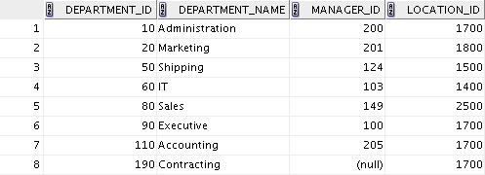
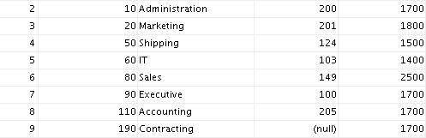
Adding a New Row to a Table
New row
DEPARTMENTS
Insert new row into the
DEPARTMENTS table.
9 - 5

Slide 6
INSERT Statement Syntax
Add new rows to a table by using the INSERT statement:
INSERT INTO VALUES
table [(column [, column...])]
(value [, value...]);
With this syntax, only one row is inserted at a time.
9 - 6

Slide 7
Inserting New Rows
Insert a new row containing values for each column.
List values in the default order of the columns in the table.
Optionally, list the columns in the INSERT clause.
INSERT INTO departments(department_id, department_name, manager_id, location_id)
VALUES (70, 'Public Relations', 100, 1700);
Enclose character and date values within single quotation marks.
9 - 7

Slide 8
Inserting Rows with Null Values
Implicit method: Omit the column from the column list.
INSERT INTO
VALUES
departments (department_id,
department_name) (30, 'Purchasing');
Explicit method: Specify the NULL keyword in the VALUES
clause.
INSERT INTO VALUES
departments
(100, 'Finance', NULL, NULL);
9 - 8

Slide 9
Inserting Special Values
The SYSDATE function records the current date and time.
INSERT INTO employees (employee_id,
first_name, last_name, email, phone_number, hire_date, job_id, salary, commission_pct, manager_id,
department_id) (113,
'Louis', 'Popp',
'LPOPP', '515.124.4567',
VALUES
SYSDATE, 'AC_ACCOUNT', 6900,
NULL, 205, 110);
9 - 9

Slide 10
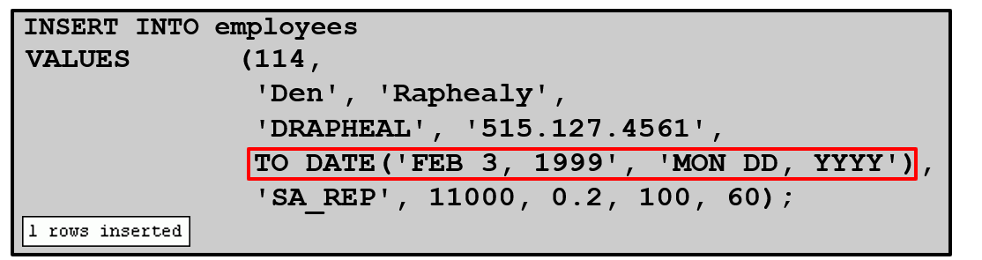
Inserting Specific Date and Time Values
Add a new employee.
Verify your addition.

Slide 11
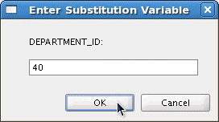
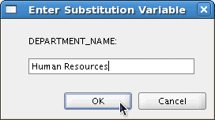
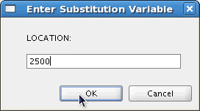
Creating a Script
Use the & substitution in a SQL statement to prompt for values.
& is a placeholder for the variable value.
INSERT INTO departments
(department_id, department_name, location_id) VALUES (&department_id, '&department_name',&location);

Slide 12
Copying Rows from Another Table
Write your INSERT statement with a subquery:
INSERT INTO sales_reps(id, name, salary, commission_pct)
SELECT employee_id, last_name, salary, commission_pct FROM employees
WHERE job_id LIKE '%REP%';
Do not use the VALUES clause.
Match the number of columns in the INSERT clause to those in the subquery.
Inserts all the rows returned by the subquery in the table,
sales_reps.

Slide 13
Lesson Agenda
Adding new rows in a table
INSERT statement
Changing data in a table
UPDATE statement
Removing rows from a table:
DELETE statement
TRUNCATE statement
Database transactions control using COMMIT, ROLLBACK, and SAVEPOINT
Read consistency
FOR UPDATE clause in a SELECT statement

Slide 14
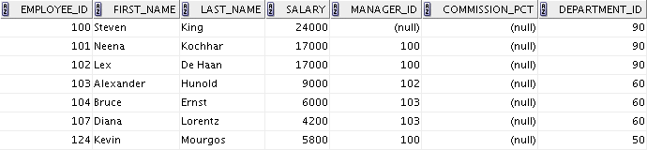

Changing Data in a Table
EMPLOYEES
Update rows in the EMPLOYEES table:

Slide 15
UPDATE Statement Syntax
Modify existing values in a table with the UPDATE
statement:
UPDATE SET | table column = value [, column = value, | ...]
[WHERE | condition];
Update more than one row at a time (if required).

Slide 16
Updating Rows in a Table
Values for a specific row or rows are modified if you specify the WHERE clause:
UPDATE employees
SET department_id = 50 WHERE employee_id = 113;
Values for all the rows in the table are modified if you omit the WHERE clause:
UPDATE SET
copy_emp department_id = 110;
Specify SET column_name= NULL to update a column value to NULL.

Slide 17
Updating Two Columns with a Subquery
Update employee 113’s job and salary to match those of employee 205.
UPDATE employees SET
job_id
salary
= (SELECT
FROM WHERE
= (SELECT
FROM WHERE
job_id employees
employee_id = 205), salary
employees employee_id = 205)
113;
WHERE employee_id =

Slide 18
Updating Rows Based on Another Table
Use the subqueries in the UPDATE statements to update row values in a table based on values from another table:
UPDATE SET
copy_emp department_id
= (SELECT department_id FROM employees
WHERE employee_id = 100)
= (SELECT job_id FROM employees
WHERE employee_id = 200);
WHERE
job_id

Slide 19
Lesson Agenda
Adding new rows in a table
INSERT statement
Changing data in a table
UPDATE statement
Removing rows from a table:
DELETE statement
TRUNCATE statement
Database transactions control using COMMIT, ROLLBACK, and SAVEPOINT
Read consistency
FOR UPDATE clause in a SELECT statement

Slide 20

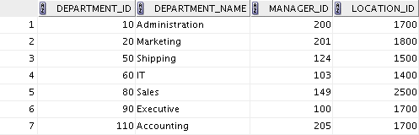
Removing a Row from a Table
DEPARTMENTS
Delete a row from the DEPARTMENTS table:

Slide 21
DELETE Statement
You can remove existing rows from a table by using the
DELETE statement:
DELETE [FROM] [WHERE
table condition];

Slide 22
Deleting Rows from a Table
Specific rows are deleted if you specify the WHERE clause:
DELETE FROM departments
WHERE department_name = 'Finance';
All rows in the table are deleted if you omit the WHERE
clause:
DELETE FROM copy_emp;

Slide 23
Deleting Rows Based on Another Table
Use the subqueries in the DELETE statements to remove rows from a table based on values from another table:
DELETE FROM employees
WHERE department_id =
(SELECT department_id
FROM departments WHERE department_name
LIKE '%Public%');

Slide 24
TRUNCATE Statement
Removes all rows from a table, leaving the table empty and the table structure intact
Is a data definition language (DDL) statement rather than a DML statement; cannot easily be undone
Syntax:
TRUNCATE TABLE table_name;
Example:
TRUNCATE TABLE copy_emp;

Slide 25
Lesson Agenda
Adding new rows in a table
INSERT statement
Changing data in a table
UPDATE statement
Removing rows from a table:
DELETE statement
TRUNCATE statement
Database transactions control using COMMIT, ROLLBACK, and SAVEPOINT
Read consistency
FOR UPDATE clause in a SELECT statement

Slide 26
Database Transactions
A database transaction consists of one of the following:
DML statements that constitute one consistent change to the data
One DDL statement
One data control language (DCL) statement

Slide 27
Database Transactions: Start and End
Begin when the first DML SQL statement is executed.
End with one of the following events:
A COMMIT or ROLLBACK statement is issued.
A DDL or DCL statement executes (automatic commit).
The user exits SQL Developer or SQL*Plus.
The system crashes.

Slide 28
Advantages of COMMIT
and ROLLBACK Statements
With COMMIT and ROLLBACK statements, you can:
Ensure data consistency
Preview data changes before making changes permanent
Group logically-related operations

Slide 29
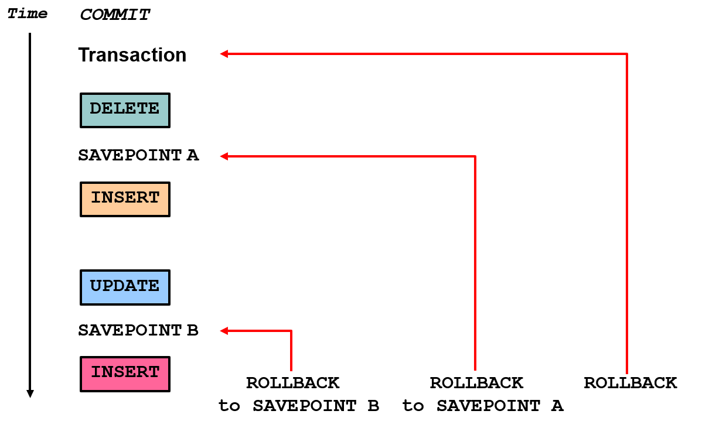
Explicit Transaction Control Statements

Slide 30
Rolling Back Changes to a Marker
Create a marker in the current transaction by using the
SAVEPOINT statement.
Roll back to that marker by using the ROLLBACK TO SAVEPOINT statement.
UPDATE...
SAVEPOINT update_done;
INSERT...
ROLLBACK TO update_done;

Slide 31
Implicit Transaction Processing
An automatic commit occurs in the following circumstances:
A DDL statement issued
A DCL statement issued
Normal exit from SQL Developer or SQL*Plus, without explicitly issuing COMMIT or ROLLBACK statements
An automatic rollback occurs when there is an abnormal termination of SQL Developer or SQL*Plus or a system failure.

Slide 32
State of the Data Before COMMIT or ROLLBACK
The previous state of the data can be recovered.
The current user can review the results of the DML operations by using the SELECT statement.
Other users cannot view the results of the DML statements issued by the current user.
The affected rows are locked; other users cannot change the data in the affected rows.

Slide 33
State of the Data After COMMIT
Data changes are saved in the database.
The previous state of the data is overwritten.
All users can view the results.
Locks on the affected rows are released; those rows are available for other users to manipulate.
All savepoints are erased.

Slide 34
Committing Data
Make the changes:
DELETE FROM employees
WHERE employee_id = 99999;
INSERT INTO departments
VALUES (290, 'Corporate Tax', NULL, 1700);
Commit the changes:
COMMIT;

Slide 35
State of the Data After ROLLBACK
Discard all pending changes by using the ROLLBACK
statement:
Data changes are undone.
Previous state of the data is restored.
Locks on the affected rows are released.
DELETE FROM copy_emp; ROLLBACK ;

Slide 36
State of the Data After ROLLBACK: Example
DELETE FROM test;
25,000 rows deleted.
ROLLBACK;
Rollback complete.
DELETE FROM test WHERE
1 row deleted.
id = 100;
SELECT * FROM test WHERE
No rows selected.
id = 100;
COMMIT;
Commit complete.

Slide 37
Statement-Level Rollback
If a single DML statement fails during execution, only that statement is rolled back.
The Oracle server implements an implicit savepoint.
All other changes are retained.
The user should terminate transactions explicitly by executing a COMMIT or ROLLBACK statement.

Slide 38
Lesson Agenda
Adding new rows in a table
INSERT statement
Changing data in a table
UPDATE statement
Removing rows from a table:
DELETE statement
TRUNCATE statement
Database transactions control using COMMIT, ROLLBACK, and SAVEPOINT
Read consistency
FOR UPDATE clause in a SELECT statement

Slide 39
Read Consistency
Read consistency guarantees a consistent view of the data at all times.
Changes made by one user do not conflict with the changes made by another user.
Read consistency ensures that, on the same data:
Readers do not wait for writers
Writers do not wait for readers
Writers wait for writers

Slide 40
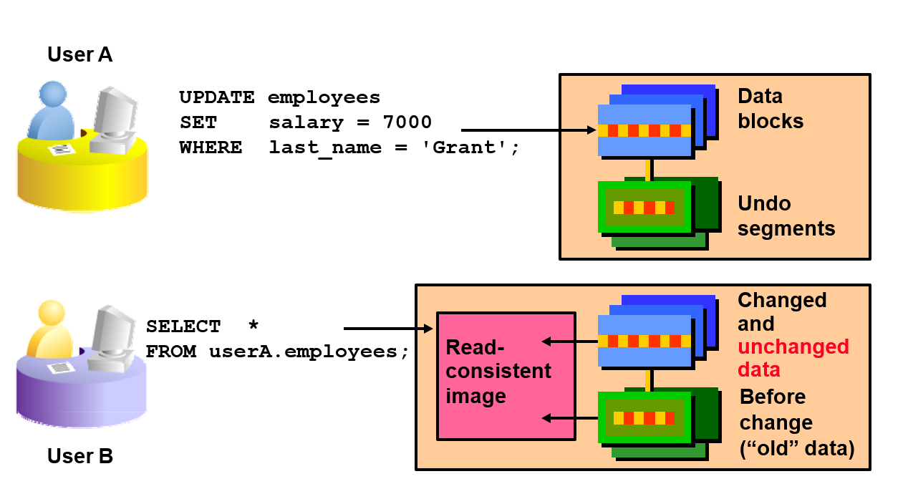
Implementing Read Consistency

Slide 41
Lesson Agenda
Adding new rows in a table
INSERT statement
Changing data in a table
UPDATE statement
Removing rows from a table:
DELETE statement
TRUNCATE statement
Database transactions control using COMMIT, ROLLBACK, and SAVEPOINT
Read consistency
FOR UPDATE clause in a SELECT statement

Slide 42
FOR UPDATE Clause in a SELECT Statement
Locks the rows in the EMPLOYEES table where job_id is
SA_REP.
SELECT employee_id, salary, commission_pct, job_id FROM employees
WHERE job_id = 'SA_REP' FOR UPDATE
ORDER BY employee_id;
Lock is released only when you issue a ROLLBACK or a
COMMIT.
If the SELECT statement attempts to lock a row that is locked by another user, the database waits until the row is available, and then returns the results of the SELECT statement.

Slide 43
FOR UPDATE Clause: Examples
You can use the FOR UPDATE clause in a SELECT
statement against multiple tables.
SELECT e.employee_id, e.salary, e.commission_pct FROM employees e JOIN departments d
USING (department_id)
WHERE job_id = 'ST_CLERK‘ AND location_id = 1500 FOR UPDATE
ORDER BY e.employee_id;
Rows from both the EMPLOYEES and DEPARTMENTS tables are locked.
Use FOR UPDATE OF column_name to qualify the column you intend to change, then only the rows from that specific table are locked.

Slide 44
Quiz
The following statements produce the same results:
DELETE FROM copy_emp;
TRUNCATE TABLE copy_emp;
True
False

Slide 45
Summary
In this lesson, you should have learned how to use the following statements:
Function | Description
INSERT | Adds a new row to the table
UPDATE | Modifies existing rows in the table
DELETE | Removes existing rows from the table
TRUNCATE | Removes all rows from a table
COMMIT | Makes all pending changes permanent
SAVEPOINT | Is used to roll back to the savepoint marker
ROLLBACK | Discards all pending data changes
FOR UPDATE clause in SELECT | Locks rows identified by the SELECT query

Slide 46
Practice 9: Overview
This practice covers the following topics:
Inserting rows into the tables
Updating and deleting rows in the table
Controlling transactions

